Slide 1
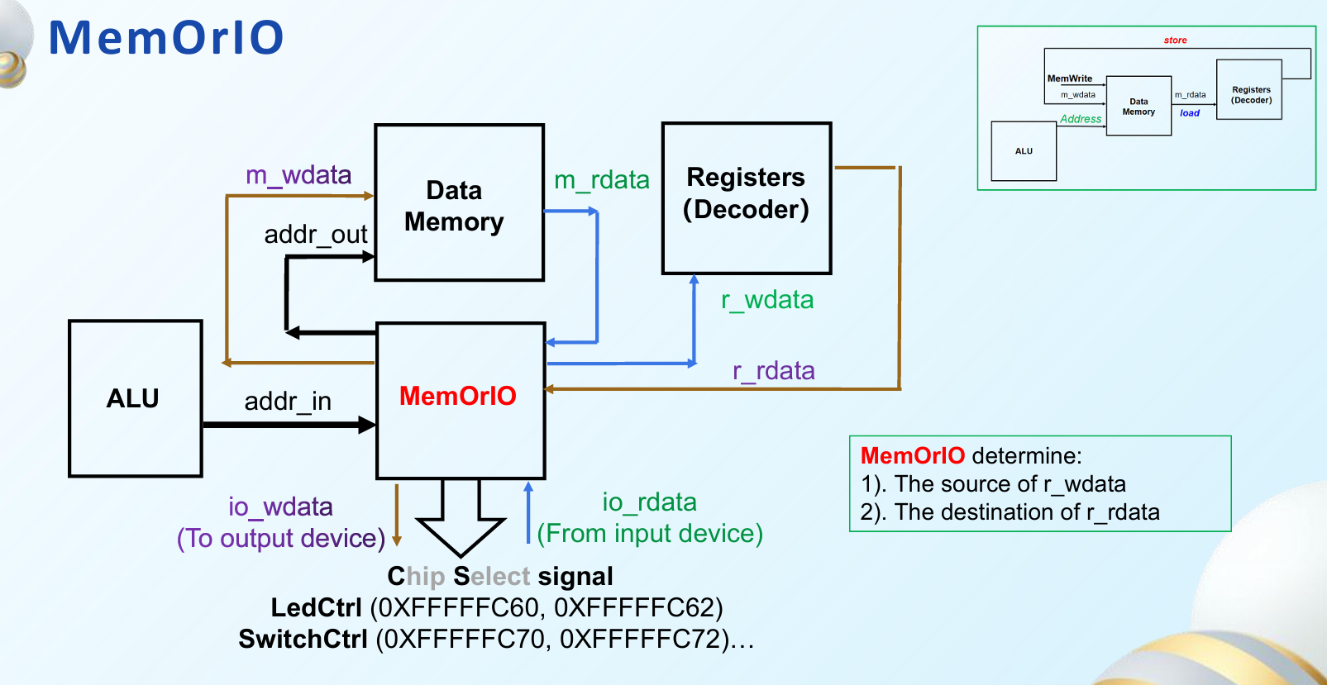
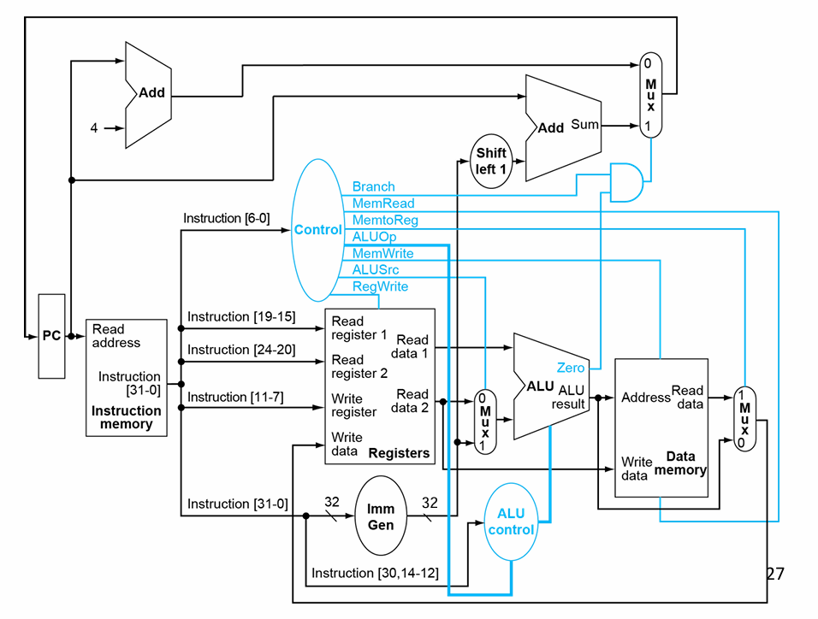
io_write_en
io_read_en
branch_taken
mem_read_en
mem_to_reg_en
alu_op
mem_write_en
alu_src
reg_write_en
m_rdata
mem_or_io
addr_in
Address
Read
data
addr_out
r_rdata
Write
data
m_wdata
Data
memory
r_wdata
io_wdata
io_rdata

Slide 2
io_write_en
io_read_en
branch_taken
mem_read_en
mem_to_reg_en
alu_op
mem_write_en
alu_src
reg_write_en
m_rdata
mem_or_io
addr_in
Address
Read
data
addr_out
r_rdata
Write
data
m_wdata
Data
memory
r_wdata
io_wdata
io_rdata

Slide 3
